Slide 1

P R E S E N T A T I O N
Estimating: Days To Sell
- JABA -

Slide 2
Goal : To investigate the influence features have on predicting time taken to sell cars (in days)
01
02
03
Predict
Days To Sell
Vehicle Feature Importance
Autotrader/ Seller Feature Importance

Slide 3
Roadmap:
Exploratory
Data
Model Fitting
Model Tuning
Feature
Analysis
Preprocessing
Importance
Data

Slide 4
Exploratory Data Analysis
1.

Slide 5
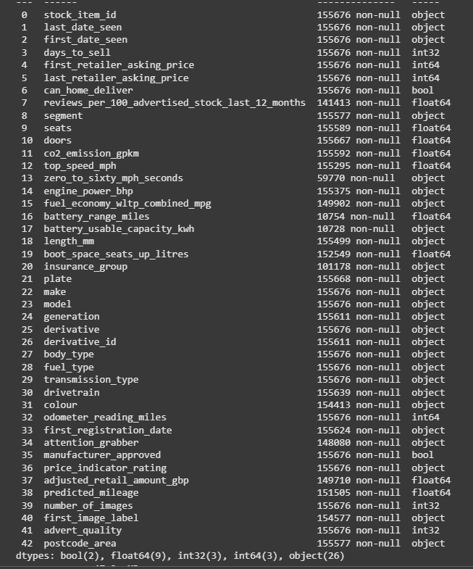
All Features

Slide 6
Top 5 Fastest Selling individual cars 🚗😀
Rank | Make Model | Days to Sell | Sold Price
1 | Volvo XC60 | 1 | £17,495
2 | Volvo XC60 | 1 | £41650
3 | Citroen C4 | 1 | £17,998
4 | Nissan Qashqai | 1 | £1,495
5 | BMW 1 Series | 1 | £9,000

Slide 7
Top 5 Worst Selling individual cars ☹️🚗
Rank | Make Model | Days to Sell | Price Drop
1 | Tesla Model 3 | 1528 (4 years) | £57,500 → £25,000
2 | Volkswagen Golf | 1455 (3 years ) | £2,999 → £1,999
3 | Land Rover Discovery 4 | 1233 (3 years) | £15,995 → £11,545
4 | BMW 2 Series | 1213 (3 years) | £13,995 → £11,995
5 | Jaguar XK | 1124 (3 years) | £19,295 → £10,995

Slide 8
Top 5 Fastest Selling Brands (make)
Rank | Make | Days to Sell (Mean)
1 | Tesla | 28
2 | MG | 34
3 | Kia | 36
4 | Nissan | 37
5 | Seat | 37
Value_count>500

Slide 9
Top 5 Slowest Selling brands (make)
Rank | Make | Days to Sell (Mean)
1 | Porsche | 58
2 | Lexus | 50
3 | Jeep | 45
4 | Suzuki | 45
5 | BMW | 44
Value_count>500

Slide 10
Days_to_sell EDA
Statistic | Values
Fastest Sale | 1 day
Longest Sale | 1528 days (over 4 years)
Mean Days to Sell | 40 days
Median (50% of sales) | 25 days
Standard Deviation (STD) | 53 DAYS
Total Car Listings | 155,676 Cars
Why did some cars take years to sell—was it overpriced, overlooked, or just unwanted? ️
And what made some car sell in just 1 day—was it an irresistible deal or the perfect ride? ⚡🚗

Slide 11
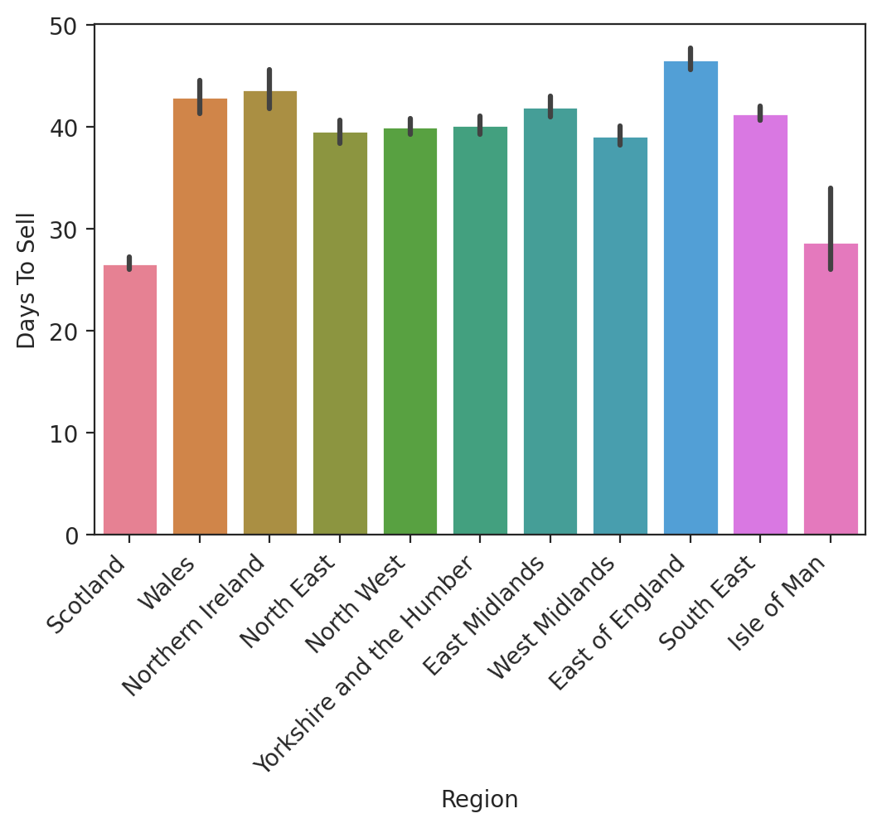
Postcodes
Postcodes used to match regions within the UK
Mean Days To Sell Calculated for:
  Postcode
  City
  Region
Interactive Map Links! (CLICK):
Mean Days To Sell for each UK Postcode:
https://sites.google.com/view/daystosellperpostcode/home
Mean Days To Sell for Different UK Regions
https://sites.google.com/view/ukregionmeandts/home

Slide 12
Data Preprocessing
2.

Slide 13
Preprocessing:
02
Outliers &
Errors
Nulls
01
04
Irrelevant: DROP
Feature Engineering
03

Slide 14
Make
Feature with missing value
Model
Generation
Missing Values
Missing/Null Values:
Imputed based on the mean for their specific make, model and generation
Separation of Electric and hybrid:
  Fuel Type
Removal of any remaining null values
General
Electric
Hybrid
Fuel Type

Slide 15
DROP
KEEP
Seller/Autotrader Features
Stock item id
Last Date Seen
First Date Seen
Can Home Deliver
Reviews per 100 advertised
Segment
Derivative id
Manufacturer Approved
Boost Space
Vehicle Features
Seats
Doors
CO2 Emissions
Engine Power
Length
Vehicle Features
Top Speed Derivative
Zero to Sixty Fuel Type
Seller/ Autotrader Features
Days To Sell Price Indicator Rating
*First Retailer Asking Price* Adjusted Retail Amount
*Last Retailer Asking Price* Predicted Mileage
Insurance Group Number Of Images
Fuel Economy Transmission Type
*Battery Range* Drivetrain
*Battery Usable Capacity* Colour
*Plate* Odometer Reading
Make
Model
Generation
*First Registration Date* First Image Label
Attention Grabber Advert Quality
Postcode Area
'*' = Used in Feature Engineering and then dropped

Slide 16
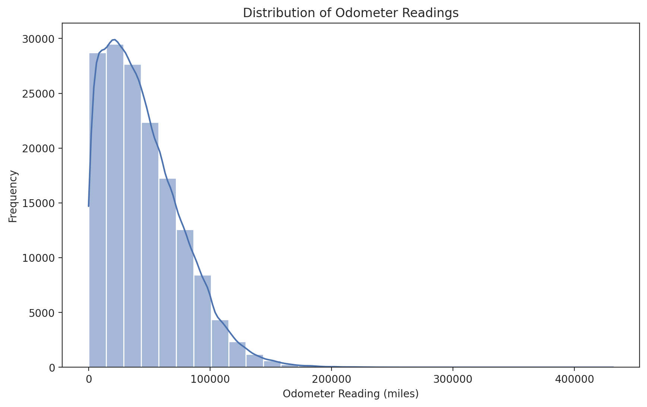
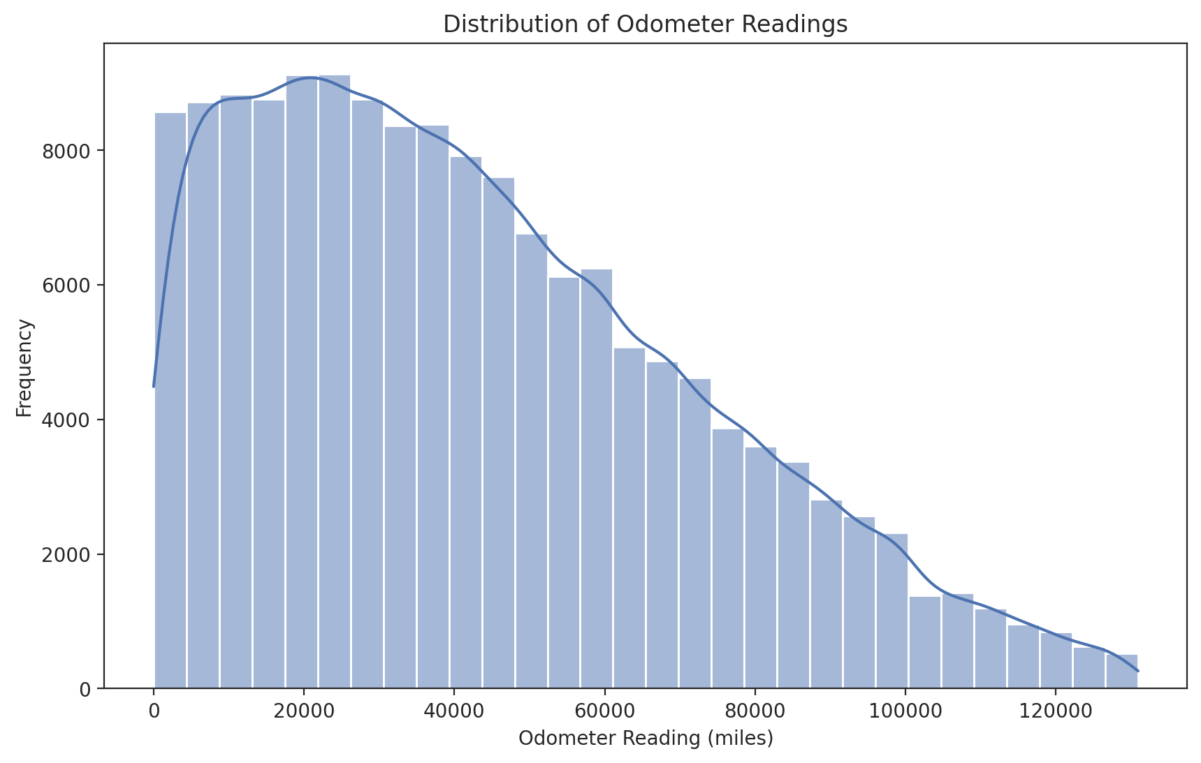
Outliers:
Based on EDA:
Outliers removed using Interquartile Range (IQR)
  Data points outside IQR Range dropped
  Reduces impact of extreme values leading to better model performance & visualizations
Days To Sell
Odometer Readings
Vehicle Age
Interquartile Range Outlier Removal
Interquartile Range Outlier Removal

Slide 17
Feature Engineering 1:
Relative Price Difference
Calculated from:
  Last retail asking price
  First retail asking price
  Can compare to other vehicles
Vehicle Age
Extrapolated from:
  Plate
  Registration Date
  Clearer Relationship
Attention Grabber Category
Created by:
  Most popular attention grabbers
  Grouped into specific categories
  (e.g. 'Navigation')
Relative Price Difference
Last Retailer Asking Price
First Retailer Asking Price
Navigation
'Sat-Nav'
'Satelite Navigation'
'Includes Sat-Nav'
Attention Grabber Category (Navigation)
Text Included in Attention Grabber

Slide 18
Feature: 'mmg_feature_dts_avg'
New feature was grouped based on:
  Make
  Model
  Generation
  Feature Column (such as postcode_area)
Feature Engineering 2:
Make
Model
Generation
Feature
mmg_feature_dts_avg
For each group, the groups mean days to sell was applied as a NEW feature: 'mmg_feature_dts_avg'​.
Why?
Helps identify trends easier
Reduces Noise & variability

Slide 19
Encoding/Transformations:
Categorical Features:
Utilising Engineered Feature ('mmg_feature_dts_avg'):
Split into Train/Test (to prevent data leakage)
Target Encoded
Numerical Features:
Standard Scaler applied on all numeric features
Improves model performance
Attempted Box-Cox transformations on days to sell:
- Decreased performance of model
Data
Numeric Features
Categorical Features
Standard Scaler()
Train-Test Split
Target Encoded

Slide 20



3 Types of Vehicles: They will use different features.
General
Hybrid
Electric

Slide 21
Model Fitting
3.

Slide 22
SIDENOTE: Deciding on a chosen model & Solution...​
Each member initially approached processing & model fitting differently and independently.
Using different scaling & categorical encoding methods.
We all used very similar algorithms (e.g. random forests).
It produced a wide range of results & differing models claimed other features to be more significant.
We decided to use the dataset that grouped make-model-gen-col using their days_to_sell mean value due to model performance!

Slide 23
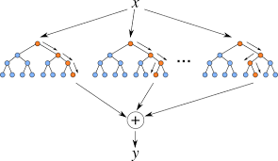
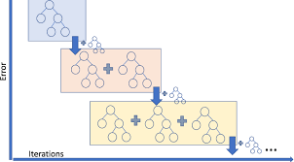
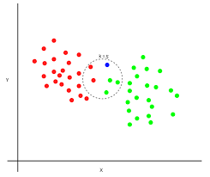
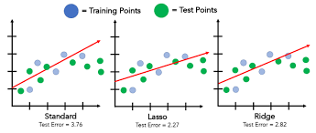
Regression Models Used:
Random Forests
Gradient Boosted Trees
KNN
https://levelup.gitconnected.com/random-forest-regression-209c0f354c84
https://pub.towardsai.net/understanding-k-nearest-neighbors-a-simple-approach-to-classification-and-regression-e4b30b37f151
https://www.researchgate.net/figure/Schematical-representation-of-gradient-boosting-regression-in-regards-to-algorithm_fig3_340524896
https://medium.com/@tyagi.lekhansh/lasso-vs-ridge-regression-a-detailed-comparison-140f7832c624
Linear, Lasso & Ridge
Regression

Slide 24
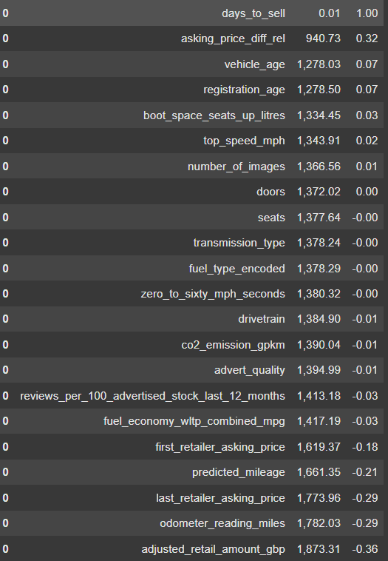
Feature Performance (General Vehicles)
Before producing our final model, we fitted a Random Forest on our categorical & numerical training data. Examining each features r^2 score, determining how well that feature explains the variance in days_to_sell.
Numerical Features:
Performance & Importance
Selected by r^2 score >0.2

Slide 25
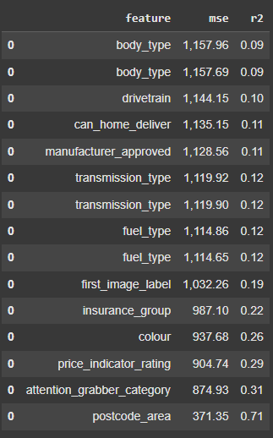
Feature Performance
(General Vehicles)
Categorical Features: Performance & Importance
Selected by r^2 score > 0.19

Slide 26
Final Features: Ready for Model Fitting
General: ​
Postcode area​
Attention_grabber_category​
Price_indicato_rating​
Colour​
Insurance_group​
First_image label​
Asking price difference​
Make​
Model​
Generation
Hybrid:
General: Features
Electric:
General features
Diff_battery_range_miles
Body_type
Transmission_type
drivetrain
*The battery_range_miles is an example of a feature that is only applicable to Electric Cars and is an important factor for customers.

Slide 27
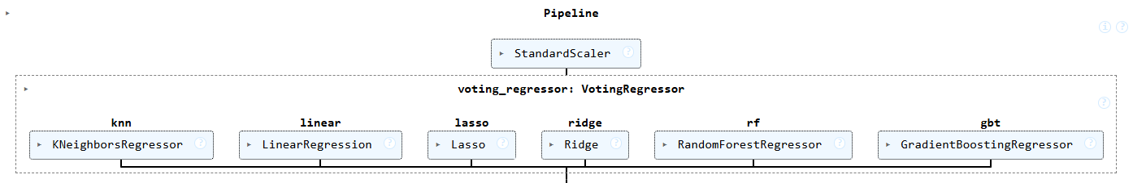
Voting Ensemble:
This allows us to combine models & get better predictions.
*We didn't use a pipeline, but this image looks pretty*

Slide 28
Metrics Used to Measure Model Performance:
Mean Squared Error (MSE) MSE= mean_squared_error (y_test, y_pred)
R-squared Score (R²)
r2 = r2_score (y_test, y_pred)
Mean Absolute Error (MAE)
MAE = mean_absolute_error (y_test, y_pred)
Median Absolute Error (MedAE)
MedAE = median_absolute_error(y_test, y_pred)
Cross-Validation Score
cross_val_test = cross_val_score(ensemble, X_test, y_test, cv=5)

Slide 29
Model Tuning
4.

Slide 30
Voting Regressor
Formed based on combinations of regression models
Train-Test Split/ Encoding
Train and Test data split.
Training
Voting Regressor fitted and trained on X-train data
Evaluation through Cross Validation
Mean Squared Error (MSE)
R2
Mean Absolute Error (MAE)
Median Absolute Error (MedAE)
Updating Model
Comparison of mean cross validation model with each iteration of model. Updating model to have the best cross validation score
Categorical Features encoded separately for X-train and X-test to prevent data leakage

Slide 31
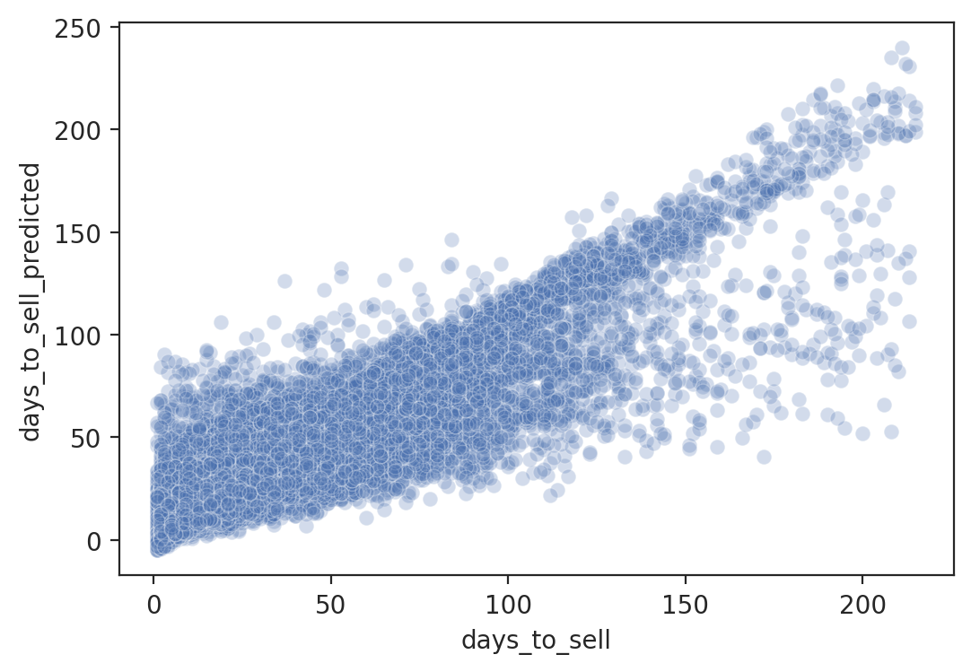
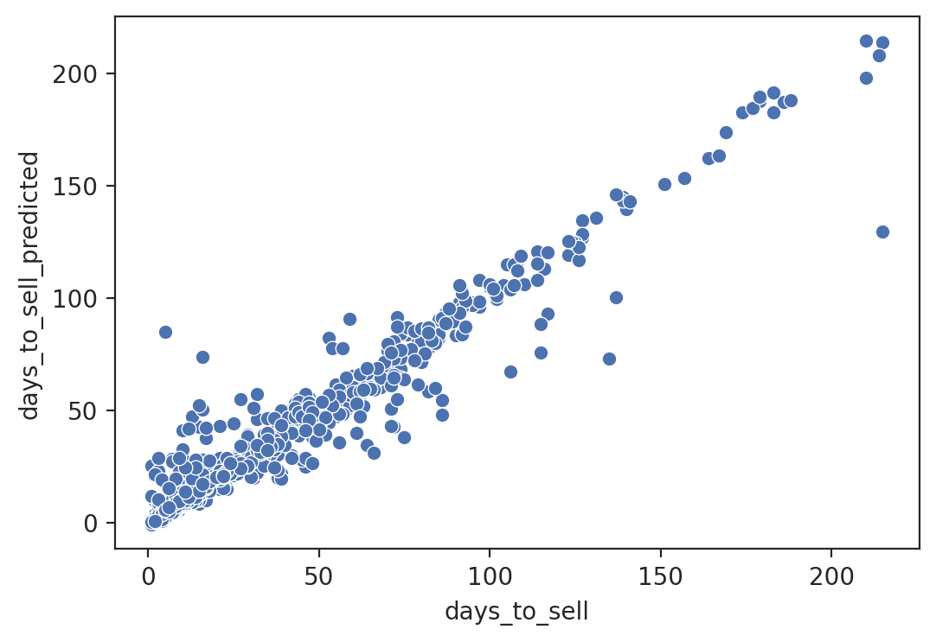
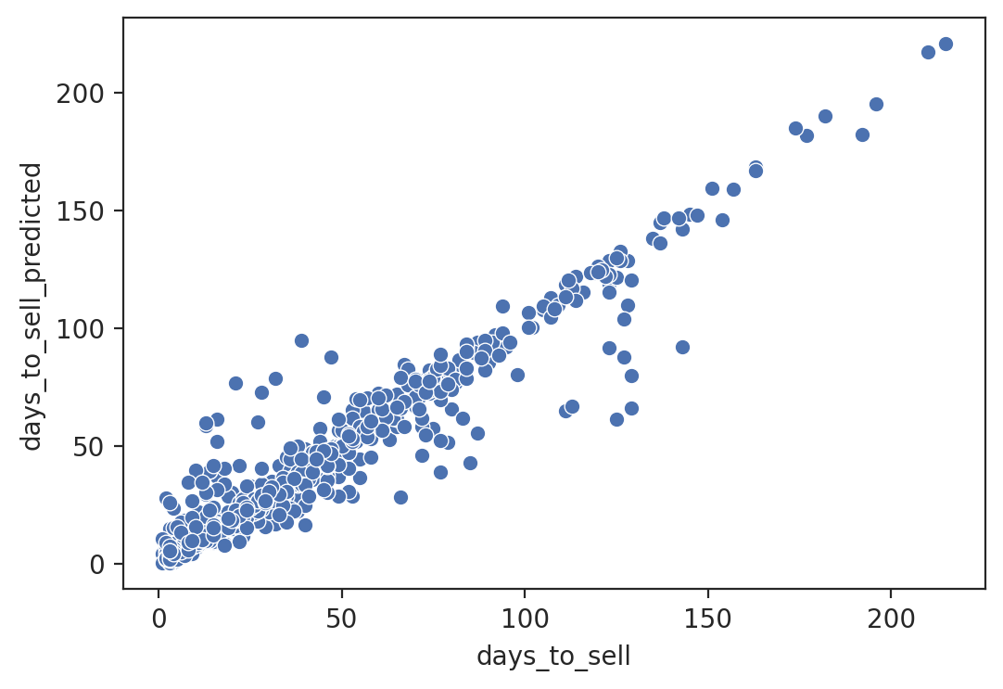
General Model Scores
Hybrid Model
Scores
Electric Model Scores
Recommendation
Current Estimators: Linear, Lasso, KNN, Forest, Gradient
Ensemble MAE: 12.26
Ensemble MedAE:7.30
Ensemble MSE: 339.2
Ensemble R2: 0.77
Cross Val Score: [0.745,0.730,0.738,0.727,0.716]
Current Estimators: Linear, Lasso, KNN, Forest, Gradient
Ensemble MAE: 5.253
Ensemble MedAE: 2.687
Ensemble MSE: 90.561
Ensemble R2: 0.940
Cross Val Score: [0.873, 0.918, 0.968, 0.943, 0.920]
Current Estimators: Linear, Lasso, KNN, Forest, Gradient
Ensemble MAE: 6.309
Ensemble MedAE: 4.113
Ensemble MSE: 88.596
Ensemble R2: 0.939
Cross Val Score: [0.936, 0.947, 0.947, 0.938, 0.920]

Slide 32
5.
Feature Importance for Main model:
SHAP, PCA, PDP & ICE

Slide 33
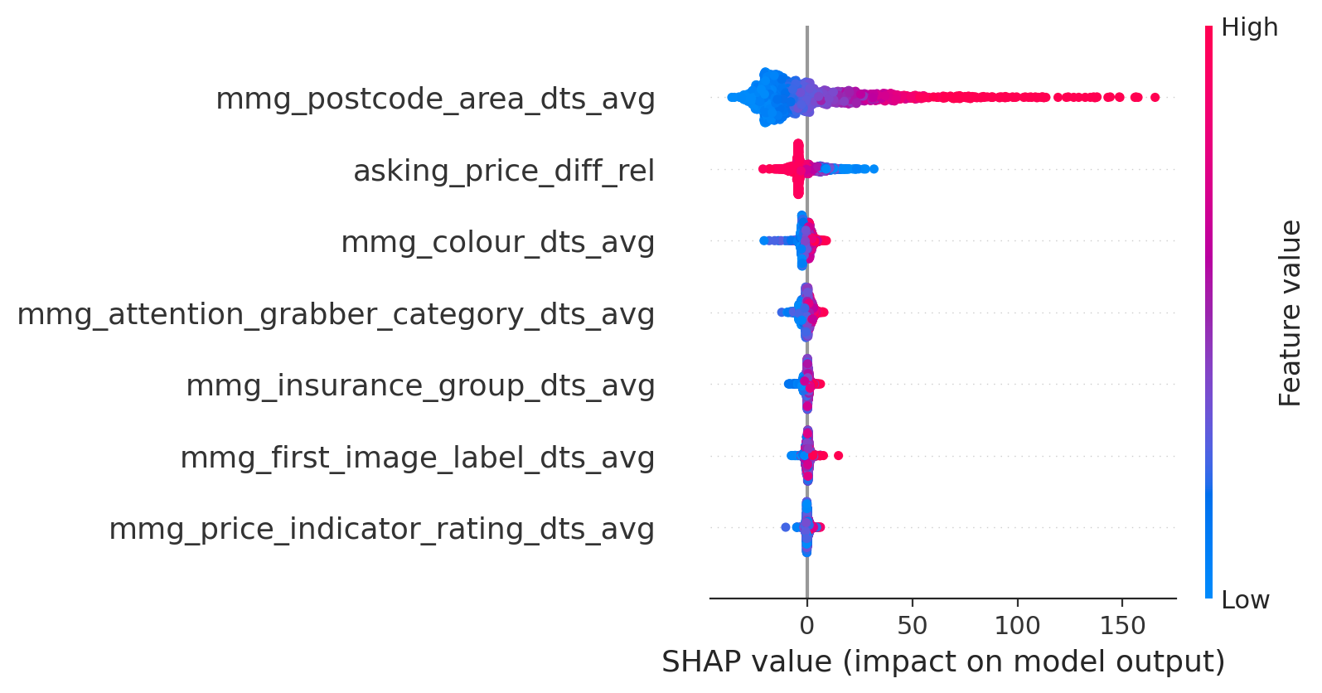
Feature Importance (SHAP)
Top 7 Most Important Features Include:
Postcode Area
Asking Price Relative Difference
Colour
Attention Grabber Category
Insurance Group
First Image Label
Price Indicator Rating
A positive SHAP value means the feature increases the prediction.

Slide 34
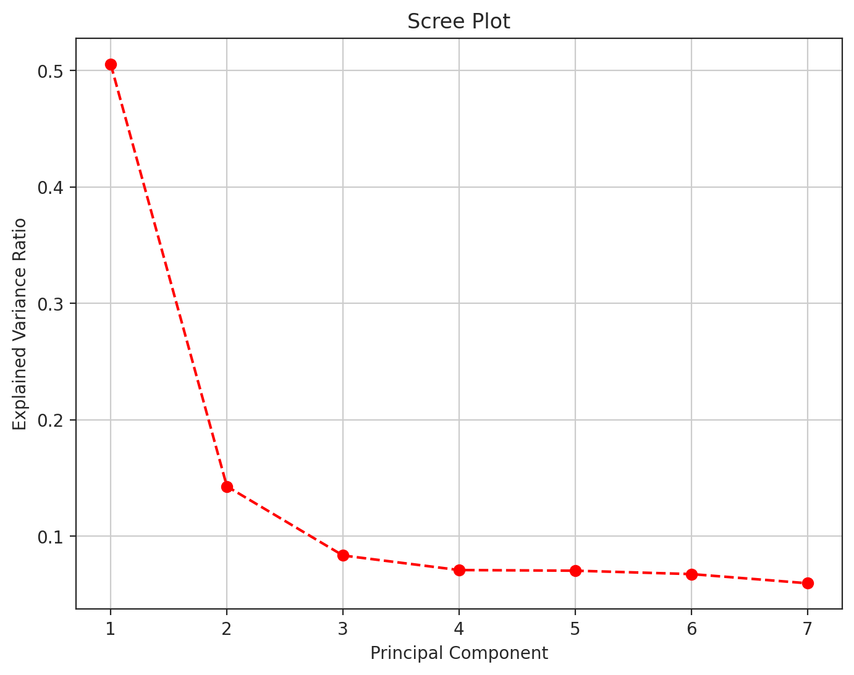
Dimensionality Reduction (PCA)
Reduce Redundant Features:
Scree Plot plateaus around 5-7 features
Features Shown in Scree Plot include:
Asking Price Relative Difference
Postcode Area**
Attention Grabber Category
Price Indicator Rating
Colour
Insurance Group
First Image Label
Why?
Reduces Overfitting
Increase Computational Efficiency

Slide 35
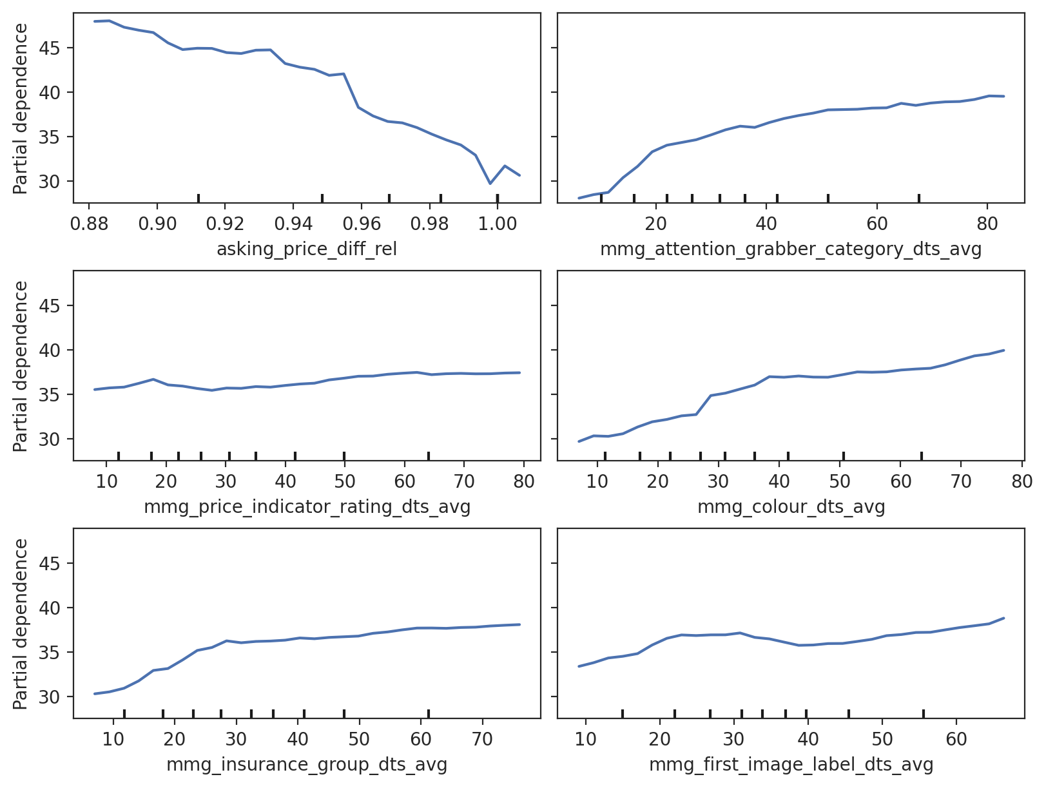
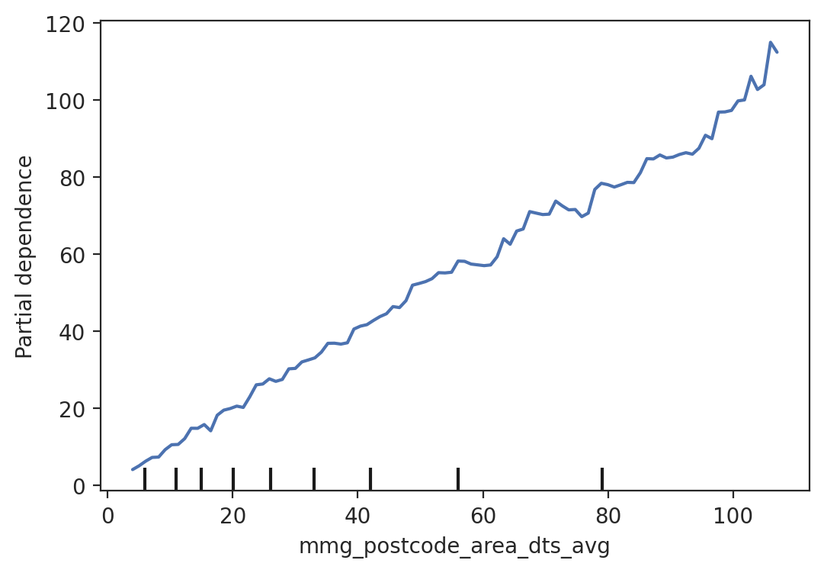
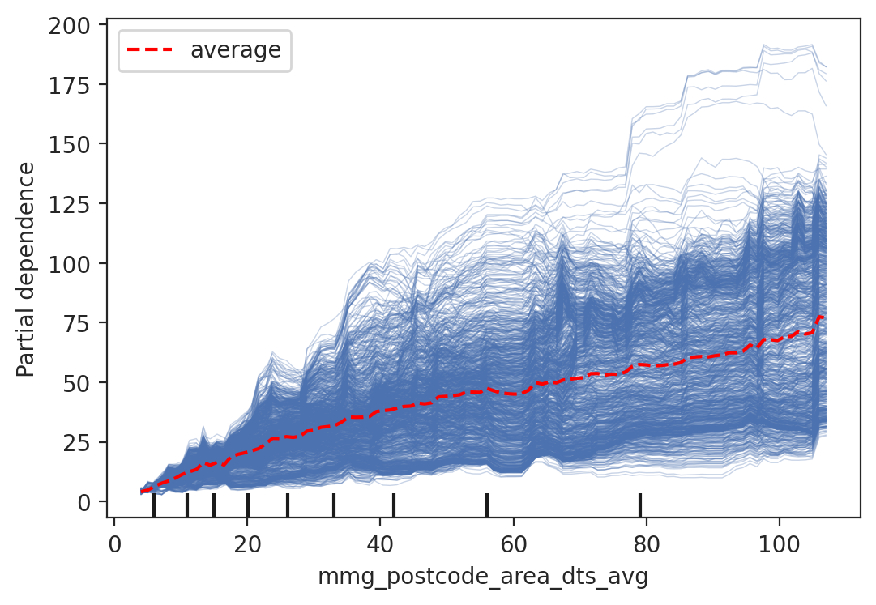
Feature Importance
(PDP & ICE)
ICE plots for top features based on 1000 subsamples. Predicted outcome for single vehicle shown to be greatly impacted by:
Postcode Area
Asking Price Relative Difference,
Attention Grabber Category,
Insurance Group,
Colour
Most Important Feature
Postcode Area

Slide 36
Conclusions
6.

Slide 37


Conclusions: What does determine days to sell?
The most important features were external factors (not the actual car itself), the quality of the ad (images, attention grabber), insurance group, postcode & the price listed.
Postcode Area and the Relative Price Difference from First Listing greatly impacts the days to sell.
Selling a car for a lower than average asking price, decreases days to sell.
Linear models are most consistent. Lower average error
Higher squared error

Slide 38
Further Research?
01
Expand electric & hybrid car data to make better models.
01
02
Investigating new vs used cars & how their days_to_sells differ.
02
Expand the dataset beyond October 2024 and add new features to analyse yearly trends in days-to-sell predictions.
03
04
Investigating days_to_sell for Sports & Luxury cars. Features that were dropped and performed poorly like zero_to_sizty_mph, top_speed may be more important.

